Slide 1
NACA0012 plunging, Pitching 해석 & CARADONNA_TUNG 해석
2021010506 김벼리

Slide 2
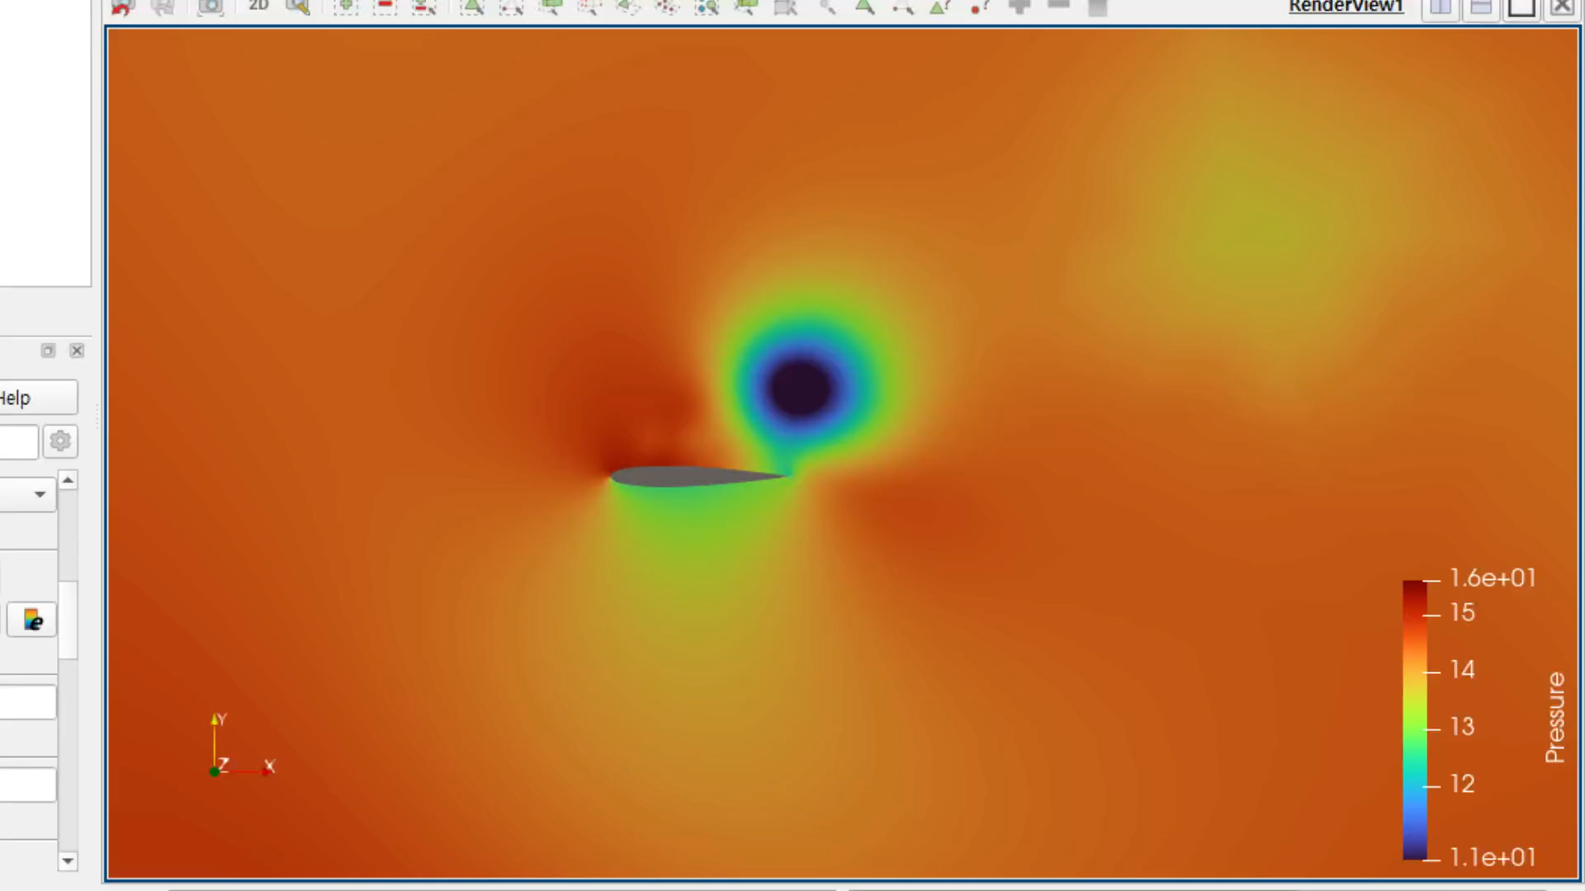
NACA0012 Plunging 조건
PLUNGING_OMEGA= 0.0 106.69842 0.0
PLUNGING_AMPL= 0.0 1.01 0.0
MACH_NUMBER= 0.3
FREESTREAM_TEMPERATURE= 288.15
AOA= 0.0
REYNOLDS_NUMBER= 1000.0
REYNOLDS_LENGTH= 1.0
CFL_NUMBER= 1.0

Slide 3
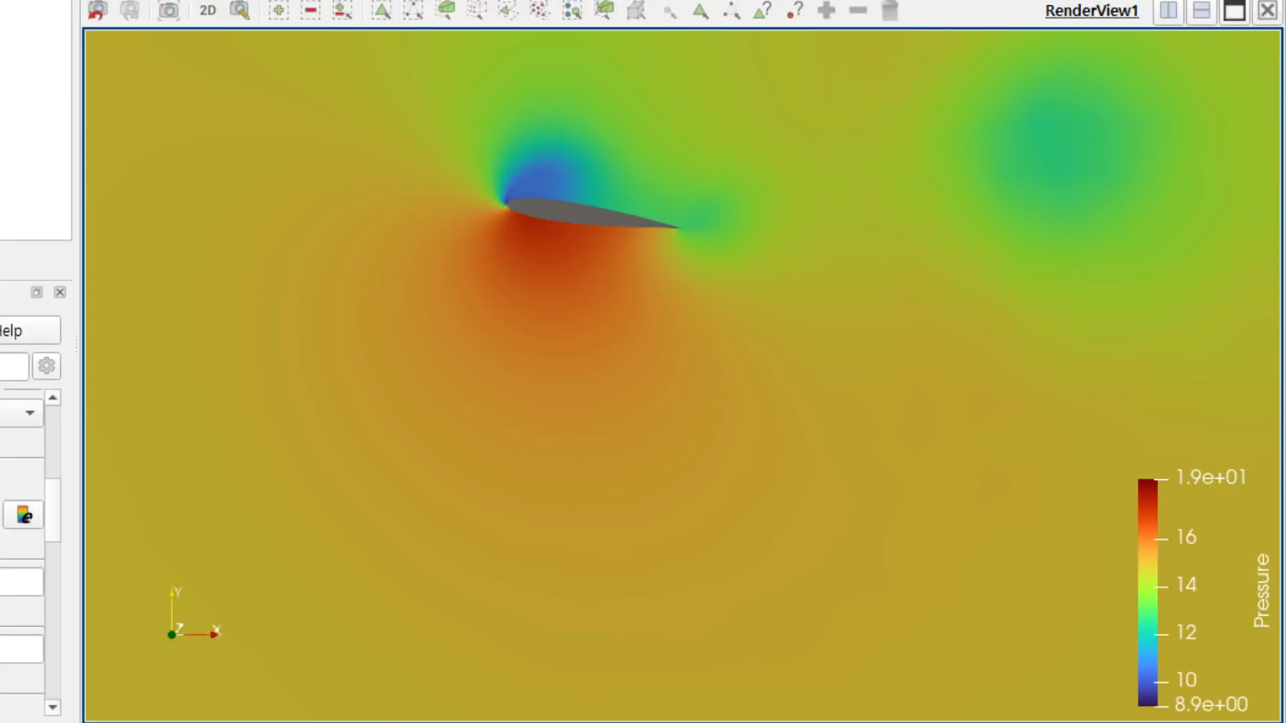
NACA0012 Plunging & Pitching 조건
GRID_MOVEMENT=RIGID_MOTION
MOTION_ORIGIN=(0.25,0.0,0.0)
PITCHING_AMPL=(0.0,0.0,8.0)
PITCHING_OMEGA=(0.0,0.0,14.91675)
PLUNGING_OMEGA= 0.0 106.69842 0.0
PLUNGING_AMPL= 0.0 1.01 0.0
CFL_NUMBER= 10
INNER_ITER= 100
MACH_NUMBER= 0.3
AOA= 17.0
FREESTREAM_TEMPERATURE= 293.0
FREESTREAM_PRESSURE= 101325.0
REYNOLDS_NUMBER= 1000.0
REYNOLDS_LENGTH= 1.0

Slide 4

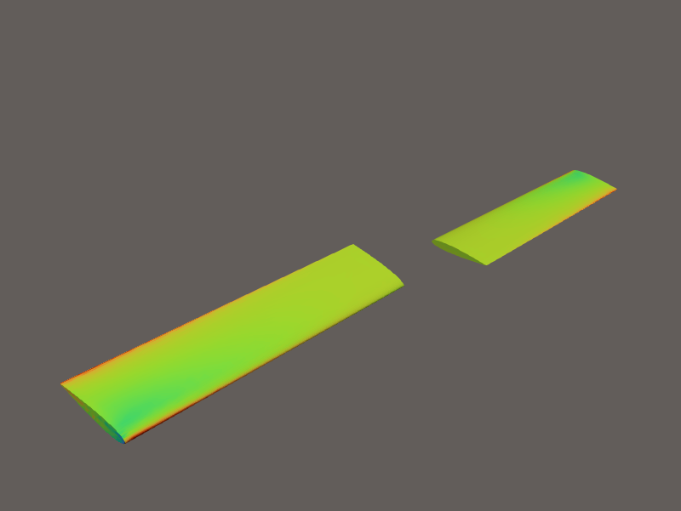
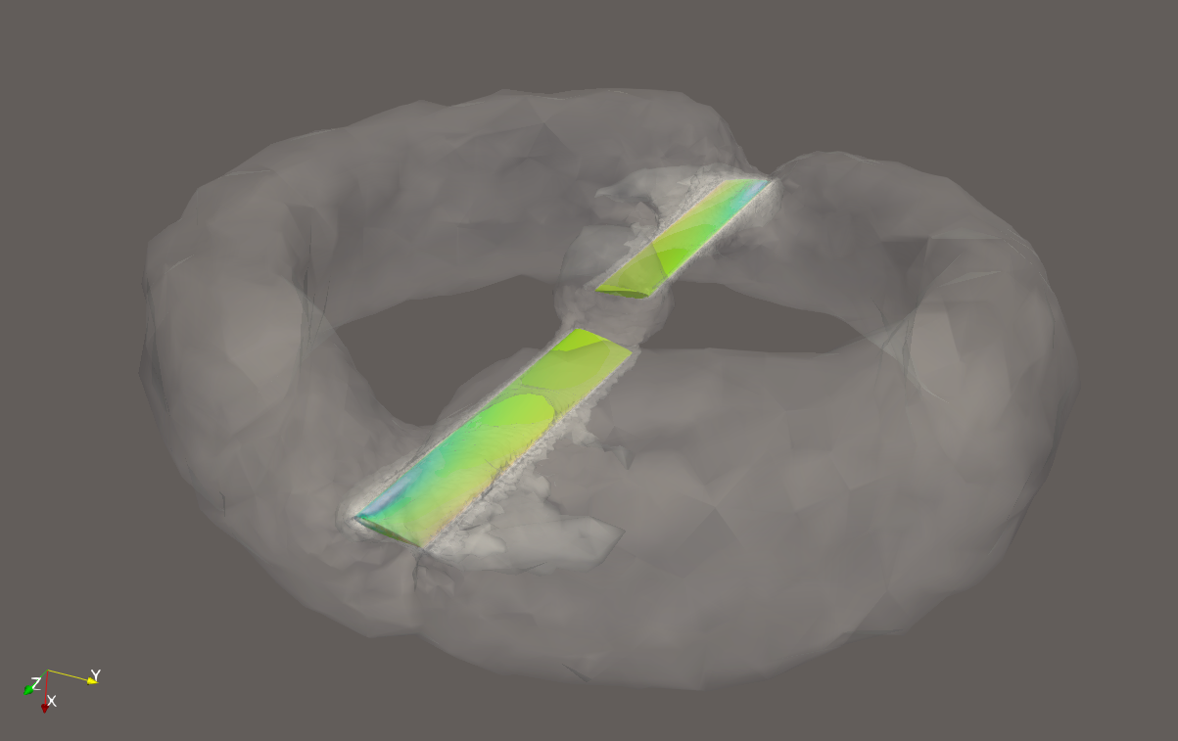
CARADONNA_TUNG blade 조건
MACH_NUMBER= 0.0
AOA= 0.0 → 호버링 상태
SIDESLIP_ANGLE= 0.0
FREESTREAM_PRESSURE= 101325.0
FREESTREAM_TEMPERATURE= 288.15
GRID_MOVEMENT= ROTATING_FRAME
MACH_MOTION= 0.877
MOTION_ORIGIN= 0.0 0.0 0.0
ROTATION_RATE = 261.79938779914943 0.0 0.0%
1250 RPM -> 130.89969389957471%
2500 RPM -> 261.79938779914943
Upper Surface
Lower Surface
Contour
*위 결과를 통해 호버링 과정에서 블레이드의 상부가 속도가 더 빠르며, 하부보다 상대적으로 저압인 것을 알 수 있음

